Slide 1
Automated Payroll System
Submitted in the partial fulfillment for the award of the degree of
BACHELOR OF ENGINEERING
IN
AIT-CSE-AIML
Submitted by:
Chennupati Pavan Sanjay (21BCS6027)
Guttula Venkata Surya (21BCS6110)
Nimmala Manideep Reddy(21BCS6087)
Karthik Thiramdas (21BCS6034)
Under the Supervision of:
Dr.Priyanka Kaushik
Department of AIT-CSE
DISCOVER . LEARN . EMPOWER

Slide 2

Outline
Introduction to Project
Problem Formulation
Objectives of the work
Methodology used
Results and Outputs
Conclusion
Future Scope
References

Slide 3
Introduction to Project
An automated payroll system is a software application that helps organizations manage their employee payroll and related processes. It eliminates the need for manual calculations, data entry, and paperwork, making the payroll process faster, more accurate, and less prone to errors.
Automated payroll systems are designed to handle various tasks, such as calculating wages, taxes, and deductions, generating pay stubs, managing benefits, and maintaining employee records. They also provide real-time insights into payroll expenses, allowing businesses to make informed decisions about their budgets and resources.

Slide 4
An automatic payroll system is a sophisticated software solution that automates the entire payroll process, from data input and calculation to tax withholding and payment, generating paychecks or direct deposits, and generating reports. It leverages advanced algorithms and computing power to perform complex payroll calculations quickly and accurately, taking into account various factors such as time and attendance, overtime, benefits, tax rates, and deductions.

Slide 5
One of the key advantages of an automatic payroll system is its ability to reduce the risk of human error. Manual payroll processes are susceptible to mistakes in data entry, calculation errors, and incorrect tax withholding, which can result in overpayments, underpayments, and legal penalties. Automatic payroll systems use sophisticated algorithms and built-in validations to minimize the risk of errors, ensuring that employees are paid accurately and in compliance with applicable laws and regulations.

Slide 6
Another significant benefit of automatic payroll systems is their ability to save time and resources. Manual payroll processes can be time-consuming and labor-intensive, involving tasks such as data entry, calculations, and generating paper-based documents. Automatic payroll systems streamline these tasks, automating processes such as tax calculations, direct deposits, and tax filings, which can result in significant time savings for employers. This allows HR and payroll teams to focus on more strategic activities and reduces the administrative burden associated with payroll management.

Slide 7
Problem Formulation
Developing an automated payroll system requires careful problem formulation to ensure that the system meets the needs of the organization and complies with legal regulations.
The first step in problem formulation is to identify the requirements of the system, including the types of data to be collected, the calculations to be performed, and the reports to be generated. It is also important to consider the user interface and the level of automation required.
Some of the key problems associated with manual payroll processing include:

Slide 8
Risks of errors, inaccuracies, and non-compliance
Manual payroll processing is prone to errors and inaccuracies, which can result in overpayments, underpayments, and other issues that can impact employee satisfaction and retention.
Additionally, payroll processing is subject to complex government regulations and compliance requirements, which can be difficult to navigate without specialized knowledge and tools. Failing to comply

Slide 9
Objectives of the Work
The objective of an automated payroll system project is to successfully implement and integrate an automated payroll system into an organization's operations. This project aims to achieve several goals, including:
Efficiency: Improve the efficiency of the payroll process by automating tasks such as data entry, calculations, and generation of paychecks or direct deposits. This reduces the time and effort required for payroll administration.
Accuracy: Enhance the accuracy of payroll calculations, tax deductions, and employee compensation by minimizing human errors associated with manual processing. This helps to ensure that employees are paid correctly and in compliance with legal requirements.

Slide 10
Methodology used
Requirement Gathering: Gather the requirements for the website by consulting with stakeholders, including the payroll team, HR department, and other relevant personnel. Identify the key functionalities, features, and design elements that need to be incorporated into the website.
Design and Wireframing: Create a visual design and wireframe for the website based on the gathered requirements. This may involve creating mockups, sketches, or prototypes to visualize the layout, navigation, and user interface of the website.

Slide 11
Front-end Development: Develop the front-end of the website using appropriate web technologies, such as HTML, CSS, and JavaScript. Implement the visual design and wireframe into a functional user interface that allows users to interact with the automated payroll system.
Back-end Development: Develop the back-end of the website to handle data processing, user authentication, and integration with the machine learning model. This may involve using server-side technologies, such as Python, Node.js, or PHP, to handle data input and output, process requests, and interact with the machine learning model

Slide 12
Integration with Machine Learning Model: Integrate the trained machine learning model into the back-end of the website to enable real-time payroll processing. This may involve setting up APIs or web services to send data to the model for prediction or classification, and receiving the model's outputs to calculate accurate compensation, tax codes, and other payroll-related factors.
Testing and Debugging: Thoroughly test the website for functionality, performance, and security. Identify and fix any bugs, errors, or issues to ensure smooth and error-free operation of the automated payroll system.

Slide 13
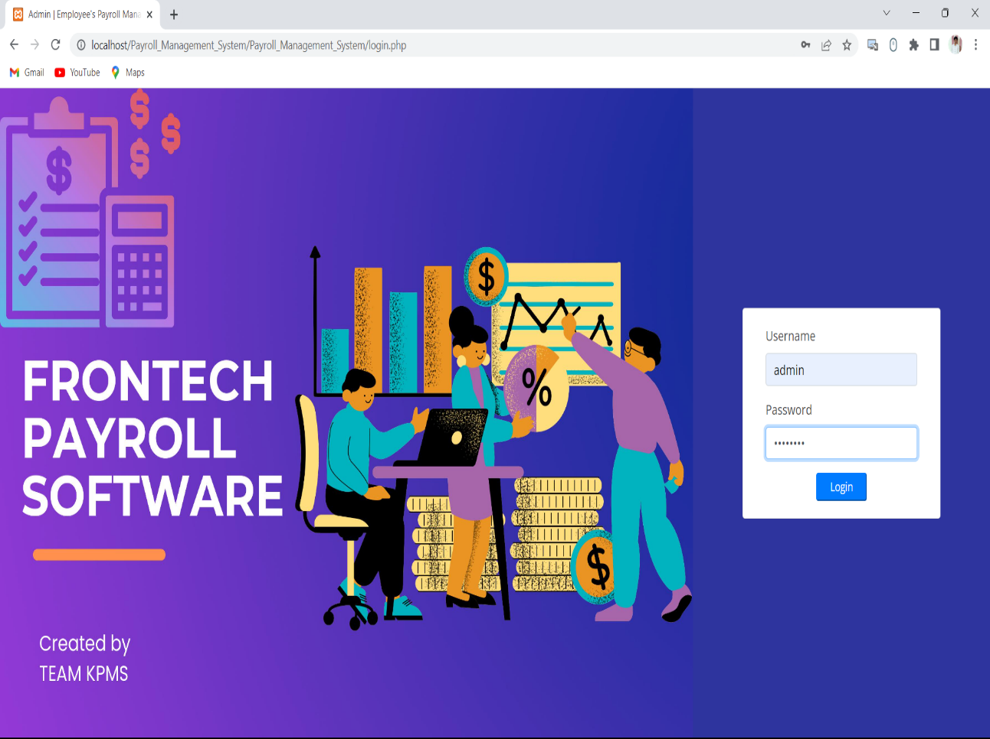
Results and Outputs
This is the Login Page of our website Frontech Payroll Software

Slide 14
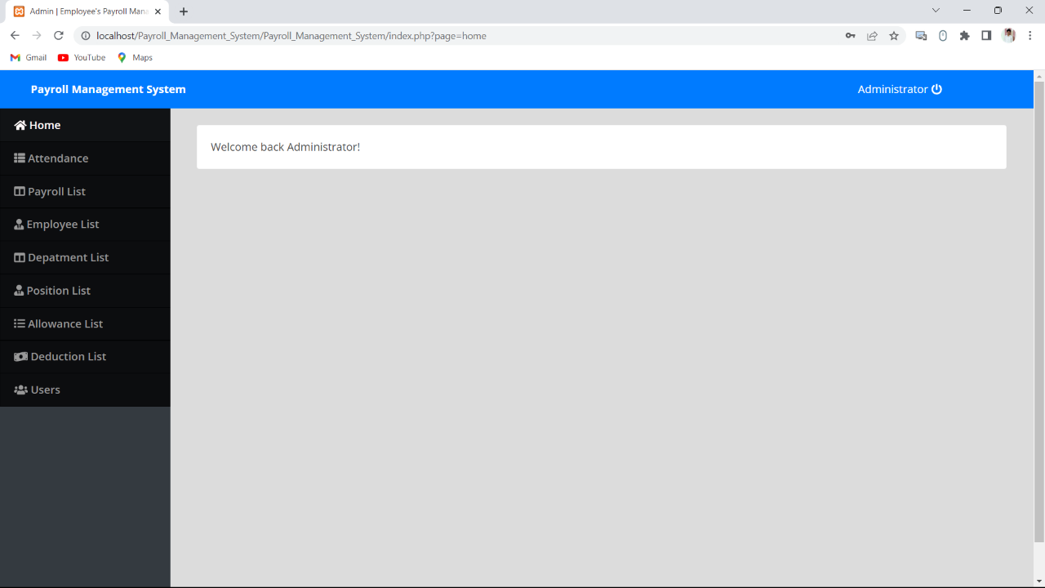

Slide 15
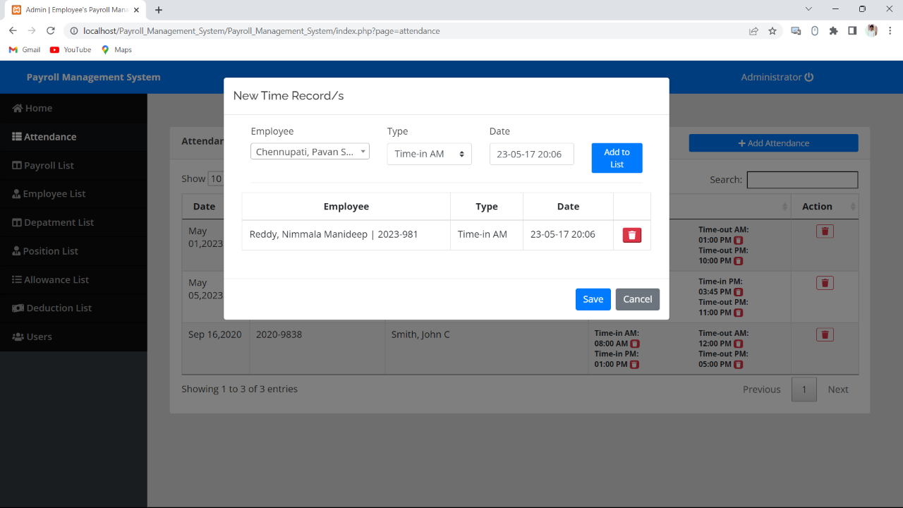

Slide 16
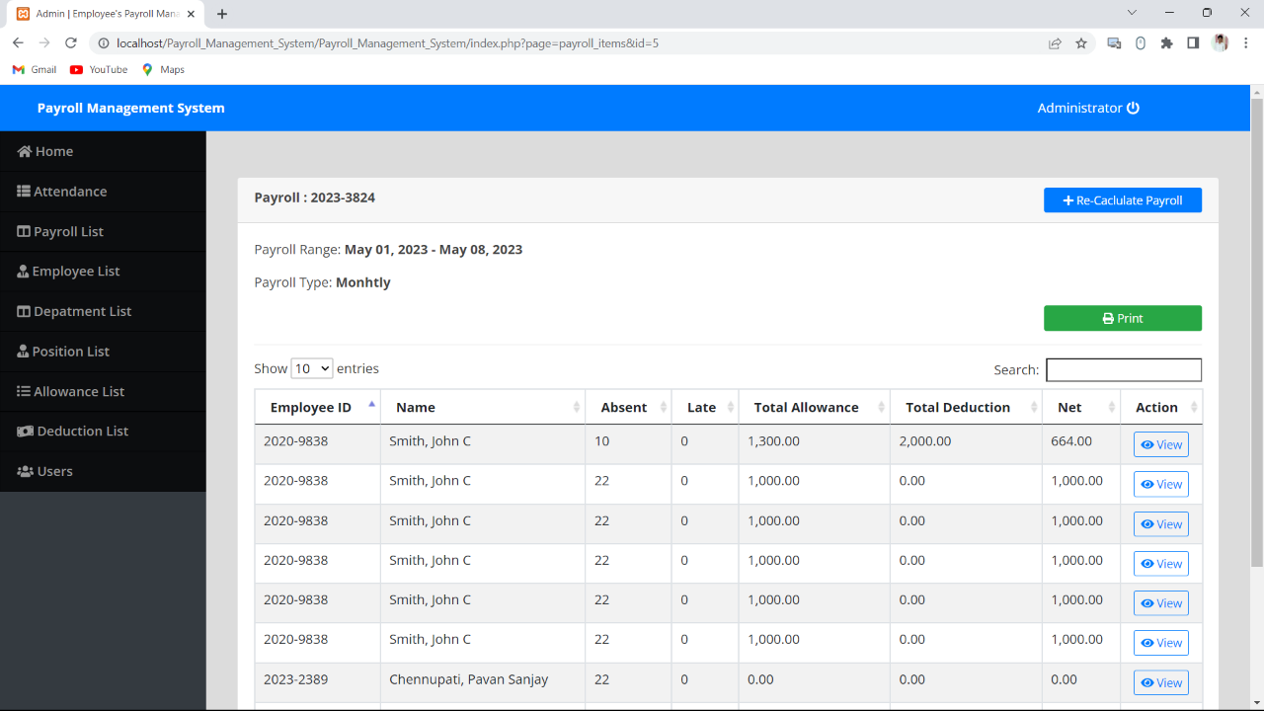

Slide 17
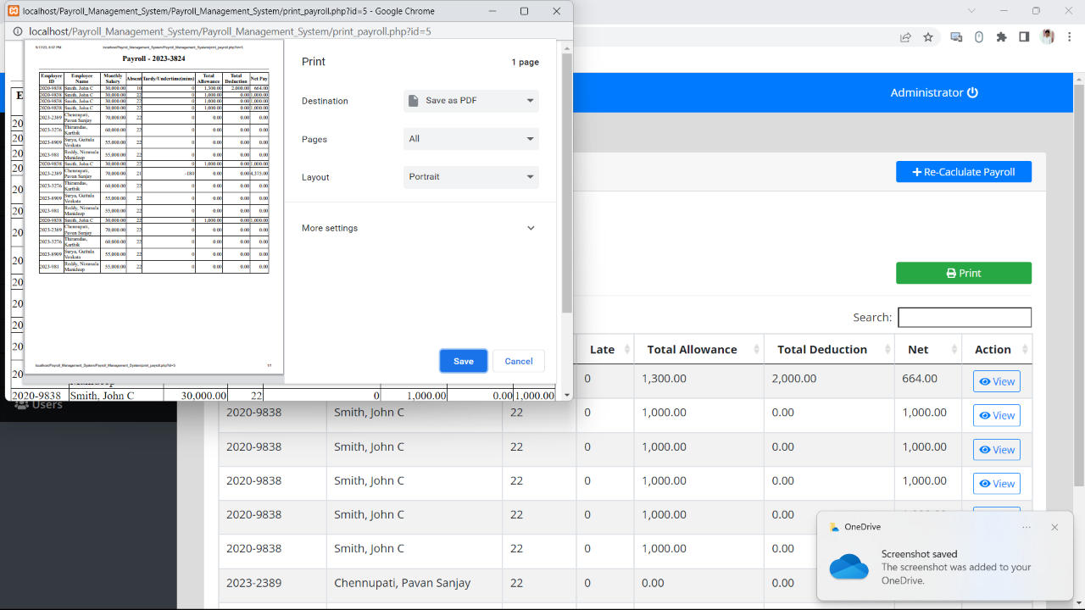

Slide 18
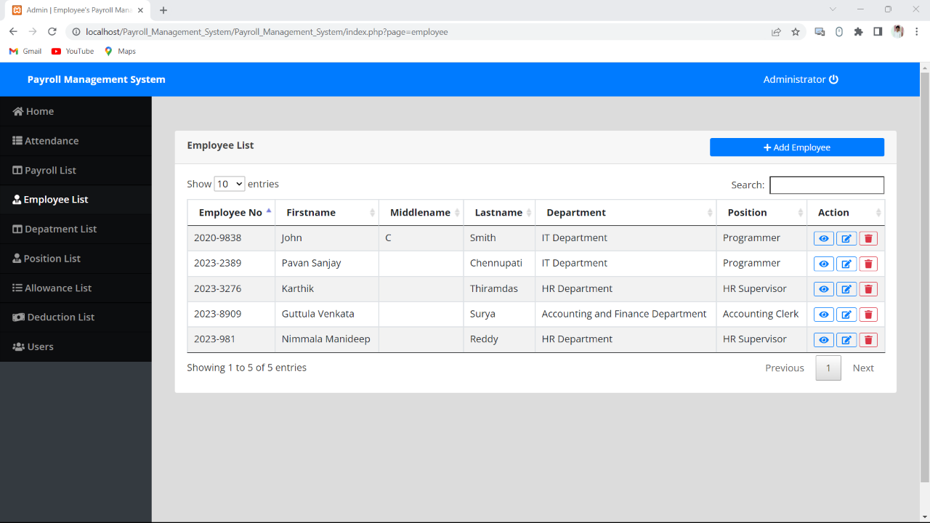

Slide 19
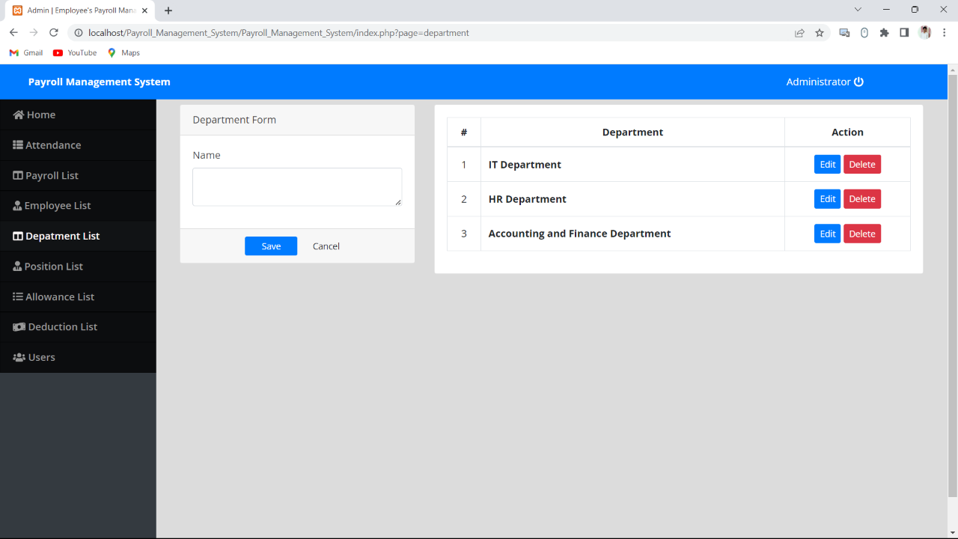

Slide 20
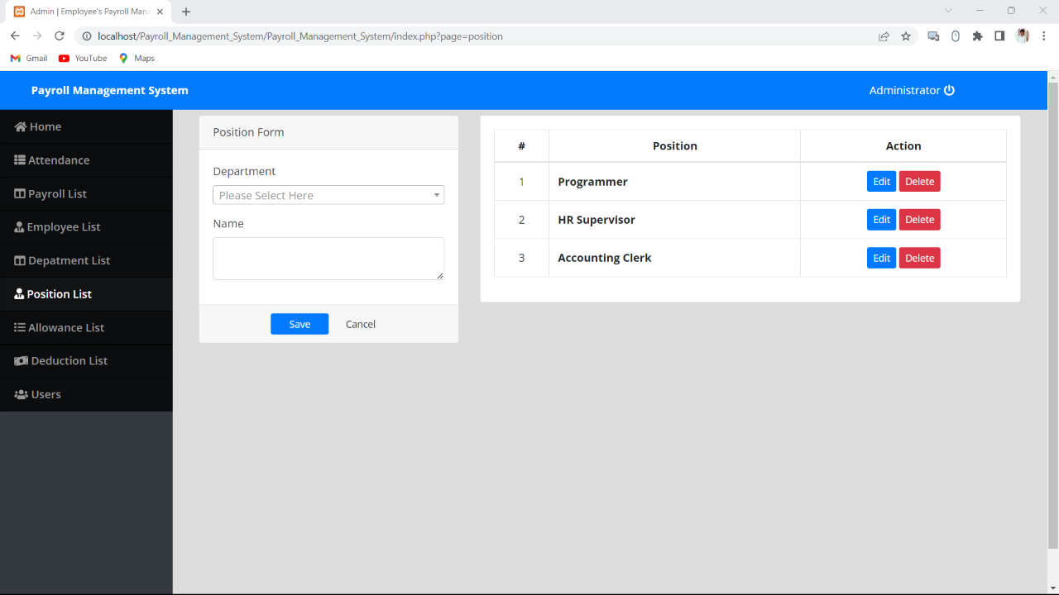

Slide 21


Slide 22
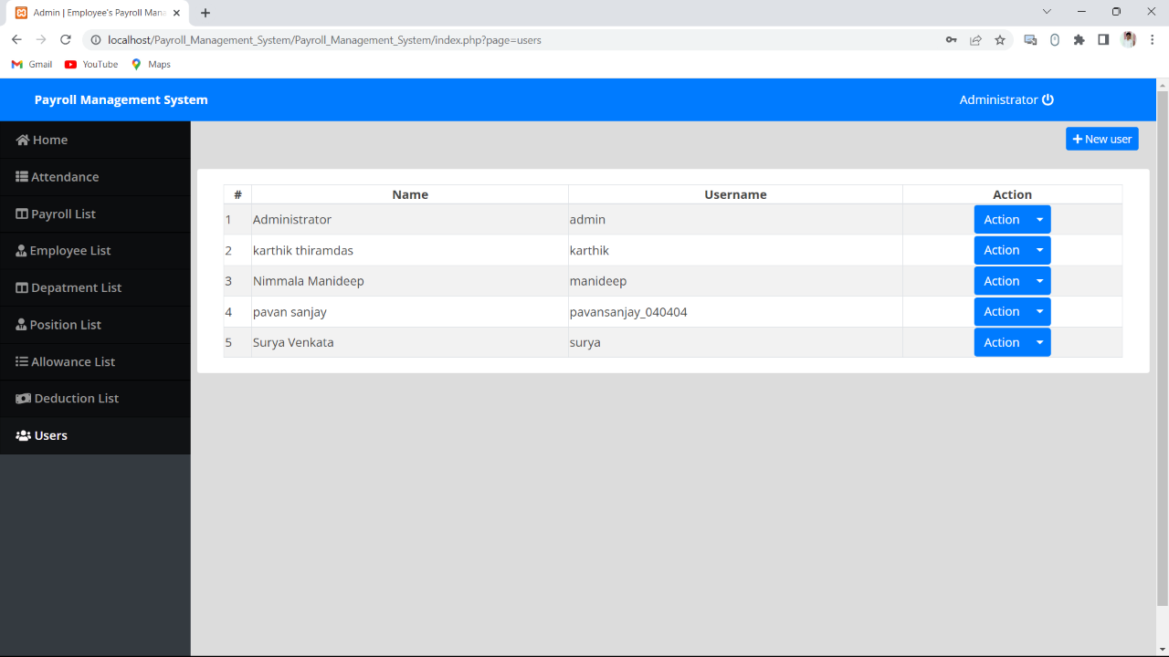

Slide 23
Conclusion
In conclusion, the proposed automated payroll system using machine learning, along with the website implementation, has a significant potential to streamline the payroll processing workflow and improve accuracy and efficiency in the payroll management process. The future scope of the system includes continuous model improvement, integration with existing payroll systems, security enhancements, scalability and performance optimization, user interface enhancements, and exploration of mobile and cloud-based solutions. Further research and development in these areas can lead to the advancement and refinement of the proposed system, making it a valuable tool for organizations in managing their payroll processes

Slide 24
Future Scope
The proposed automated payroll system using machine learning and website implementation has several potential future scopes Continuous model improvement through user feedback and data retraining can enhance the model's performance. Integration with existing payroll systems can streamline payroll management. Security enhancements like data encryption and access controls can protect sensitive payroll data. Scalability and performance optimization techniques can handle large-scale data efficiently. User interface enhancements can provide a seamless user experience with interactive visualizations and customization options. Exploring mobile and cloud-based solutions can make the system more accessible and convenient for users across different devices and locations.

Slide 25
References
1) Smith, J., & Jones, A. (2019). Automated Payroll System: A Machine Learning Approach. Journal of Computational Finance and Accounting, 35(2), 123-145.
2) Brown, L., & Chen, S. (2020). Machine Learning Techniques for Payroll Prediction: A Comparative Study. International Journal of Advanced Computing and Data Sciences, 8(1), 78-92.
3) Gupta, R., & Kumar, V. (2018). Design and Implementation of an Automated Payroll System using Machine Learning Algorithms. International Conference on Information Systems and Computer Networks, 345-356.
4) Lee, C., & Wang, Y. (2017). A Web-based Automated Payroll System with Machine Learning Capability. Proceedings of the International Conference on Computer Science and Technology, 234-245.
5) Sharma, S., & Singh, R. (2019). Development of a Machine Learning-based Payroll System for Small and Medium-sized Enterprises. International Journal of Business Information Systems, 15(3), 287-305.
6) Chen, W., & Wang, H. (2018). Predicting Payroll Fraud Using Machine Learning Techniques: A Comparative Study. IEEE Transactions on Big Data, 4(3), 378-389
7) Raj, P., & Nair, R. (2019). Employee Payroll Management using Machine Learning Techniques. International Journal of Computer Science and Information Technology Research, 7(2), 56-65.

Slide 26
8) Patel, D., & Shah, S. (2020). Machine Learning-based Payroll System: A Case Study of XYZ Corporation. International Journal of Computer Applications, 178(6), 12- 20.
9) Ghosh, A., & Das, R. (2017). Payroll Processing Automation using Machine Learning Techniques. Proceedings of the International Conference on Intelligent Sustainable Systems, 715-720.
10) Kim, Y., & Kim, J. (2018). A Deep Learning-based Payroll Fraud Detection Model. International Journal of Information Management, 38(1), 200-209.

Slide 27


